Slide 1
Adventure Works
Adventure Works Sales & Performance Analysis

Slide 2
Group members
Nimmakuri . Ramya Harini
Golla Sabhina
Abhishek Kumar
Jindam Nikitha
Geethanjali M
Gouse Saklen
Anup Nair

Slide 3
Project summary
Analyzed AdventureWorks sales data using SQL, Excel, and Power BI to evaluate sales performance, customer behavior, product trends, and regional performance. Developed interactive dashboards with KPIs, charts, filters, and slicers, performed data transformation and modeling, and generated actionable business insights for better decision-making.

Slide 4
Workflow Followed
Data Collection
Data Cleaning
&Preparation
Data Modeling
Data Analysis
Insights & Interpretation
Dashboard Creation
Visualization

Slide 5
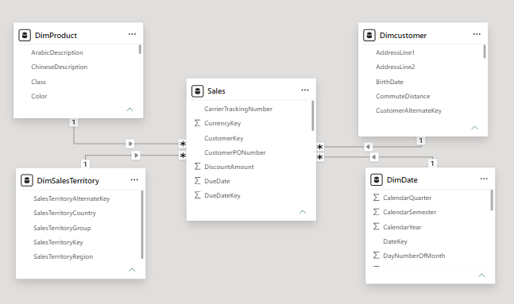
Data Model: Star Schema
Fact Table: Sales
Dimension Tables: Date, Product, Customer, Sales Territory
Data Modeling

Slide 6
Project Objectives
The main objectives of the project were:
Analyze overall sales and profitability.
Understand year-wise, month-wise, and quarter-wise sales trends.
Identify top-performing products and customers.
Compare performance across different regions.
Analyze production cost and profit.
Create interactive dashboards for business performance monitoring.
Generate meaningful insights to support data-driven decisions.

Slide 7
Key Takeaways:
Total Sales: The company generated approximately 29M in total sales from around 28K orders.
Profitability: The business earned approximately 12M profit against a 17M production cost, indicating a strong overall profit contribution.
Year-wise performance: 2013 was the best-performing year, with sales of approximately 16.35M, much higher than 2011 and 2012.
Monthly sales: June recorded the highest monthly sales, at approximately 3.06M, while February had the lowest, at around 1.74M.

Slide 8
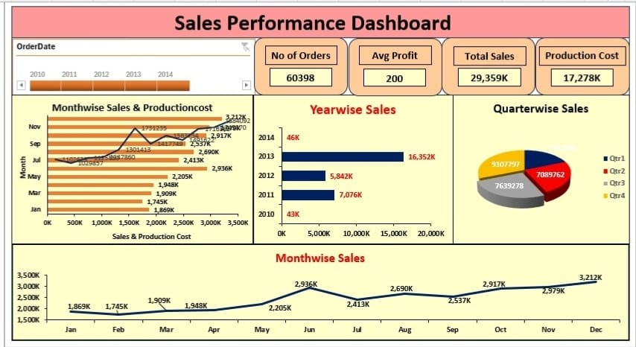
Key Insights from Dashboard
This Excel dashboard represents the sales performance of Adventure Works. It provides important KPIs such as total orders, average profit, total sales, and production cost. The dashboard also analyzes sales by month, year, and quarter.

Slide 9
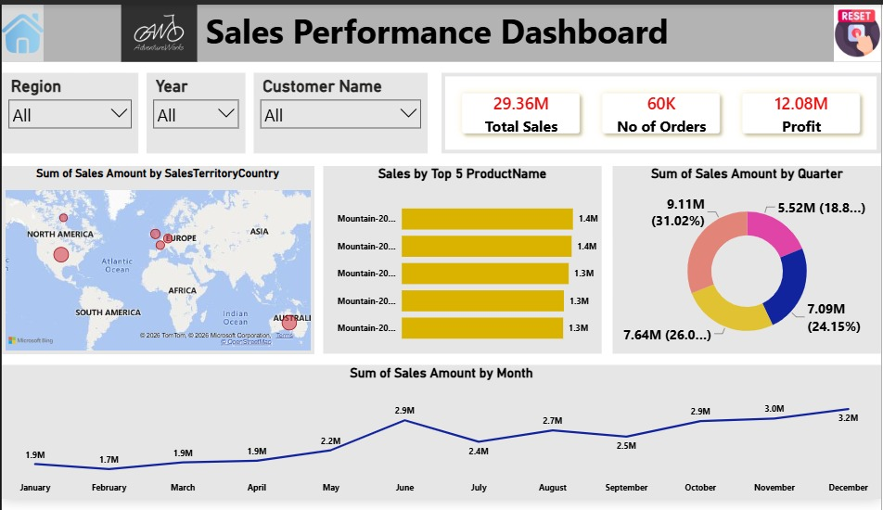
Key Insights from Dashboard
This Power BI dashboard provides a clear and interactive view of sales performance. It helps management monitor KPIs, compare regions and products, analyze quarterly and monthly trends, and make better business decisions based on sales and profit data.

Slide 10
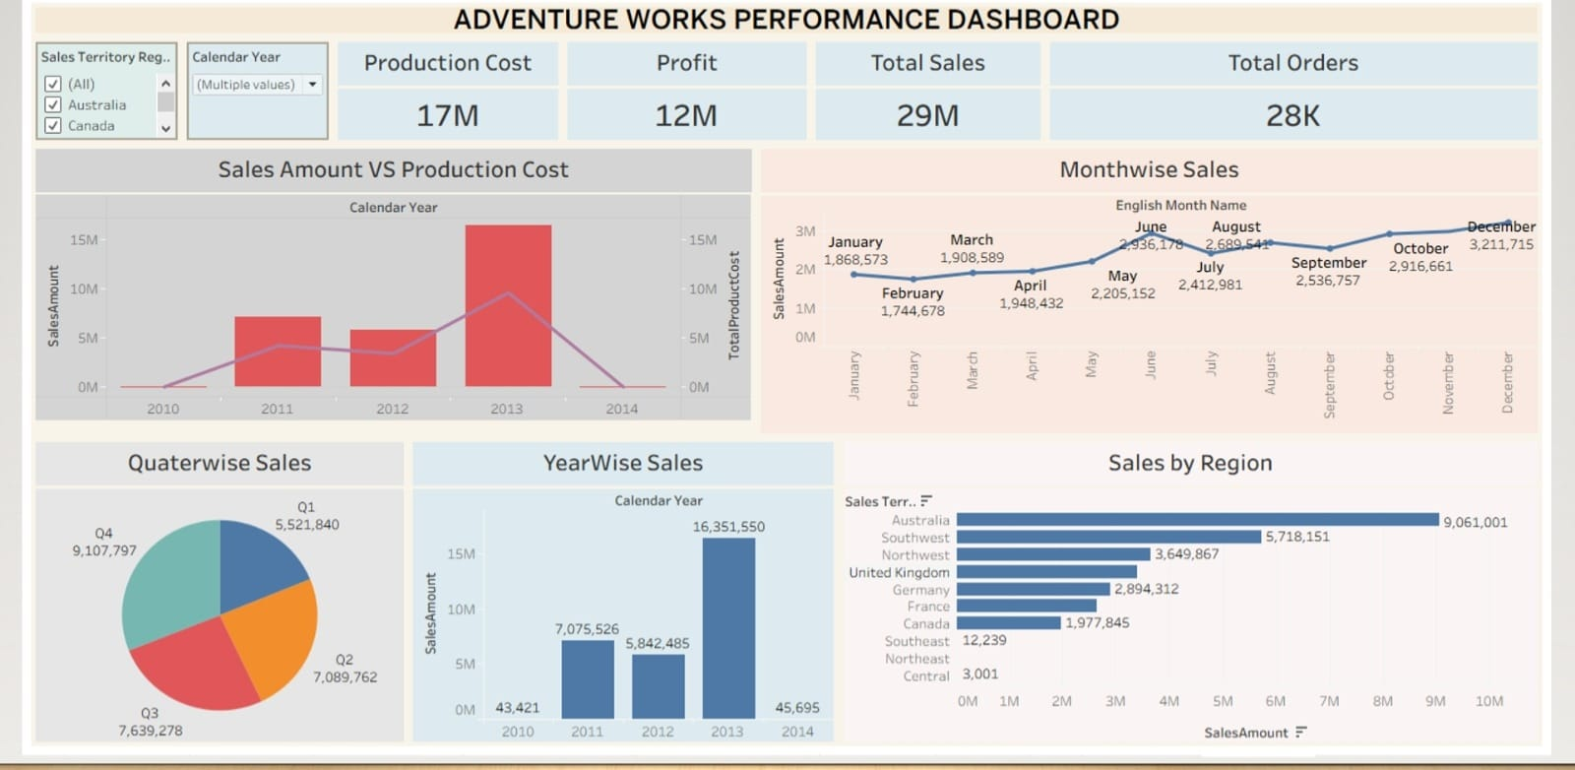
Key Insights from Dashboard
The Adventure Works Tableau dashboard provides a complete view of business performance. It helps management track sales, profit, production cost, orders, and regional performance. The dashboard shows that 2013 had the highest yearly sales, Q4 had the highest quarterly sales, December had the highest monthly sales, and Australia was the top-performing region.

Slide 11
Key Insights and Interpretation:
The dashboard indicates that Adventure Works performed strongly overall, generating 29M in sales and 12M in profit. The significant increase in sales during 2013 suggests strong business growth during that period.
Australia is the company's strongest sales region, so maintaining its performance could be important. At the same time, lower-performing regions such as Central and Southeast could be investigated to understand factors such as demand, customer base, or market coverage.
The monthly and quarterly analysis shows that sales fluctuate throughout the year. The particularly strong performance in June and Q4 can help the company plan inventory, marketing campaigns, and sales strategies around high-demand periods.

Slide 12
Conclusion:
The Adventure Works Sales Analysis provides a clear view of sales, profit, production cost, orders, time-based trends, and regional performance. By using data cleaning, data analysis, visualization, and interactive dashboards, meaningful business insights can be identified from the raw data. The analysis shows that 2013 was the strongest sales year, Australia was the leading region, June had the highest monthly sales, and Q4 was the strongest quarter. These insights can help the business improve regional strategies, plan inventory, and focus on high-performing periods to drive future growth. Overall, the project demonstrates how data analytics tools can transform business data into actionable information for decision-making

Slide 13
Future Scope:
1. Sales Forecasting 📈
Use Machine Learning to predict future sales based on historical sales data.
2. Customer Segmentation 👥
Group customers based on purchasing behavior, location, spending, and frequency.
3. Real-Time Dashboard 🔄
Connect Power BI to a live/updated database so that sales information refreshes automatically.
4. Profitability Analysis 💰
Extend the analysis from sales to profit, profit margin, discounts, and costs to understand actual business performance.

Slide 14
Thank You

